Slide 1
AMiDST Analysis of Massive Data STreams
Tutorial: initial steps for setting up AMIDST toolbox and using it
June 3 2016

Slide 2
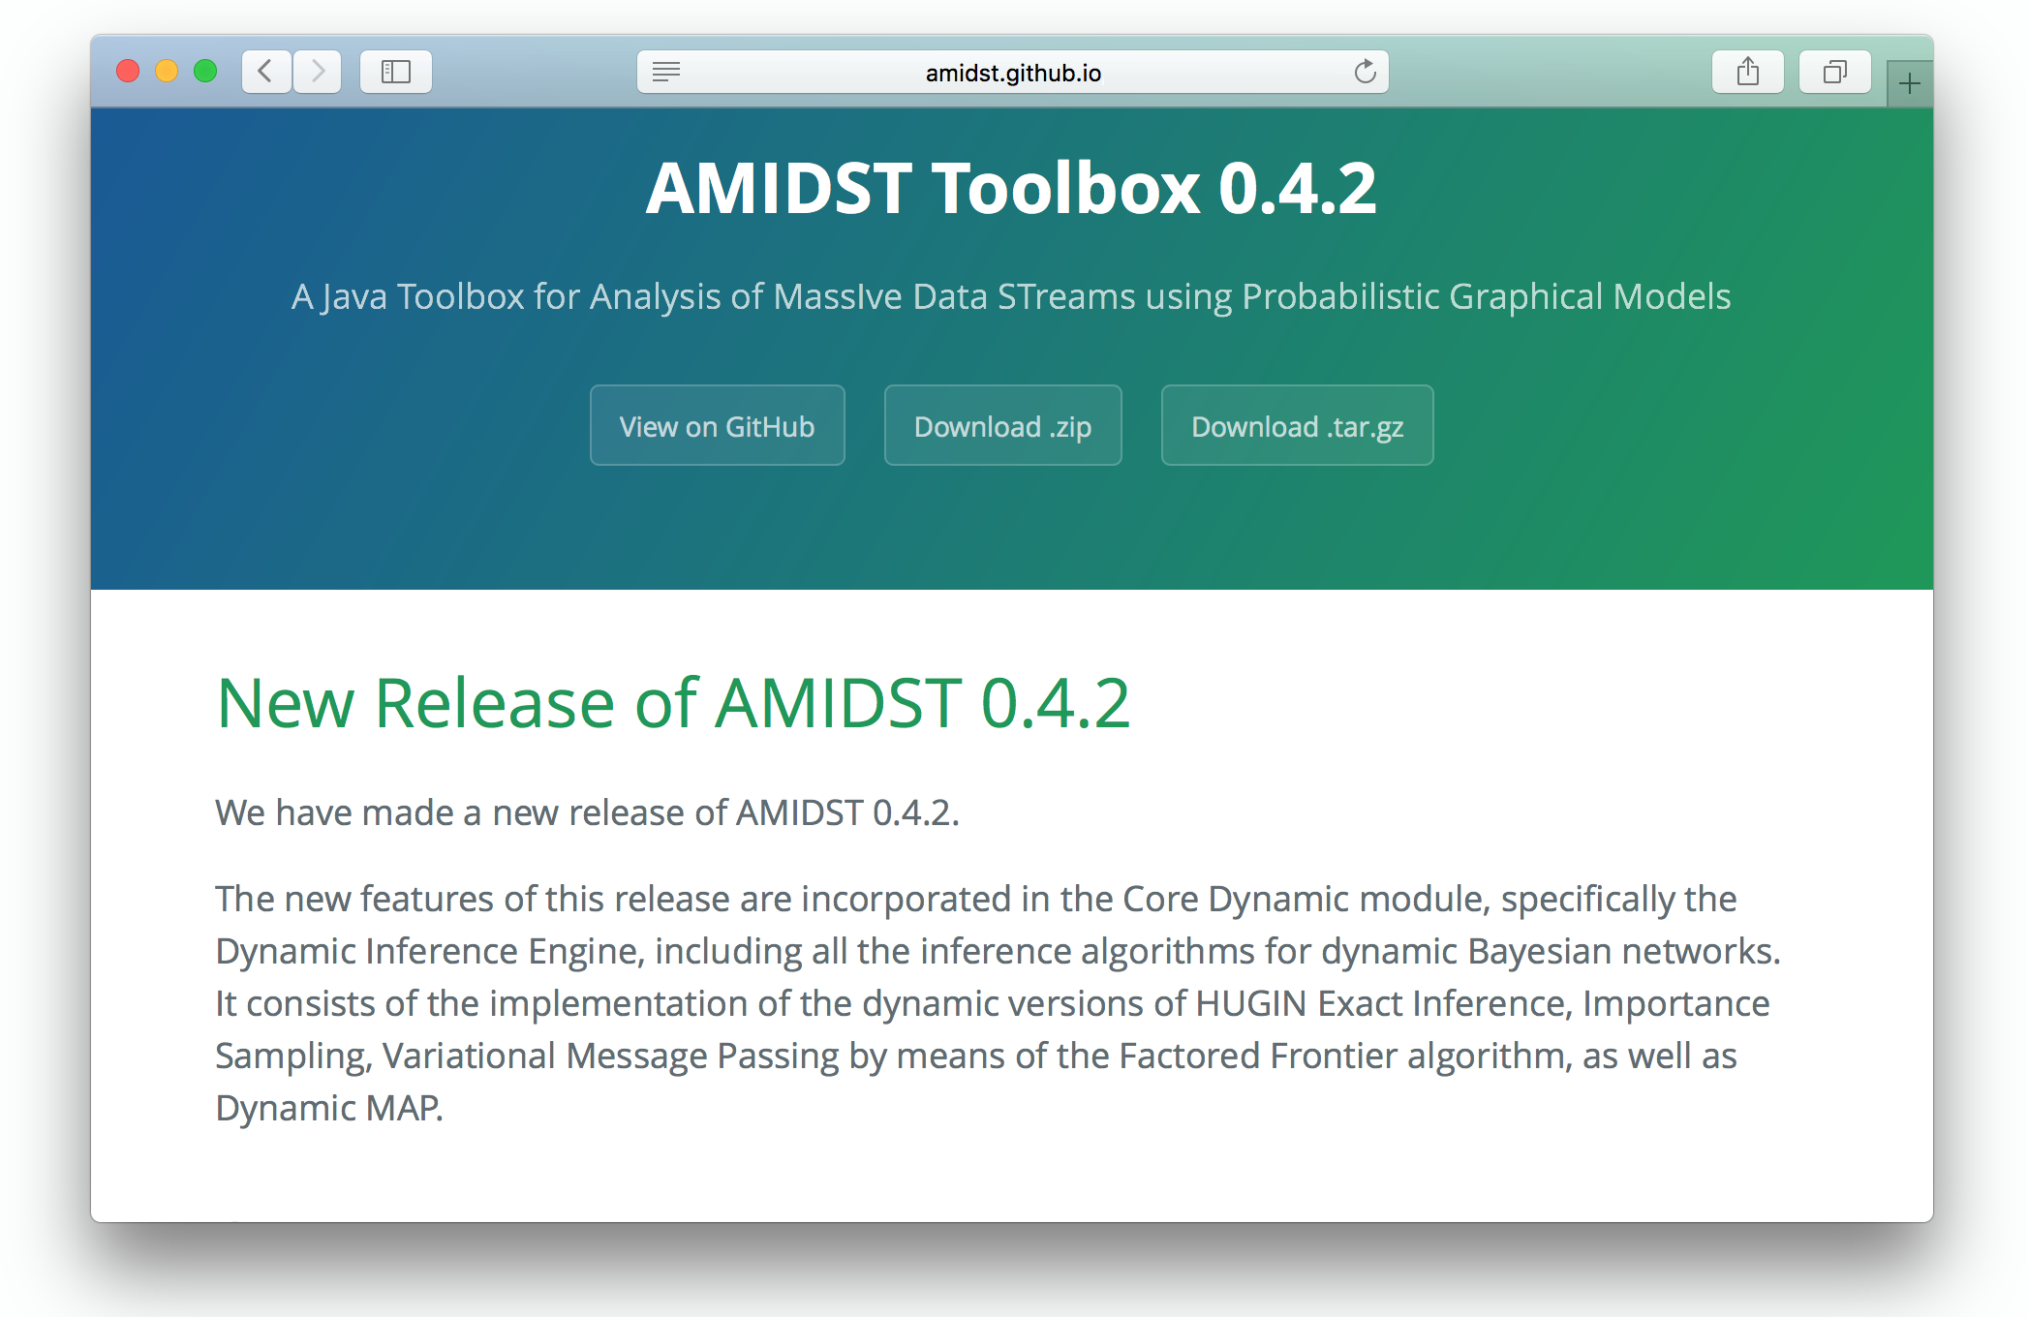
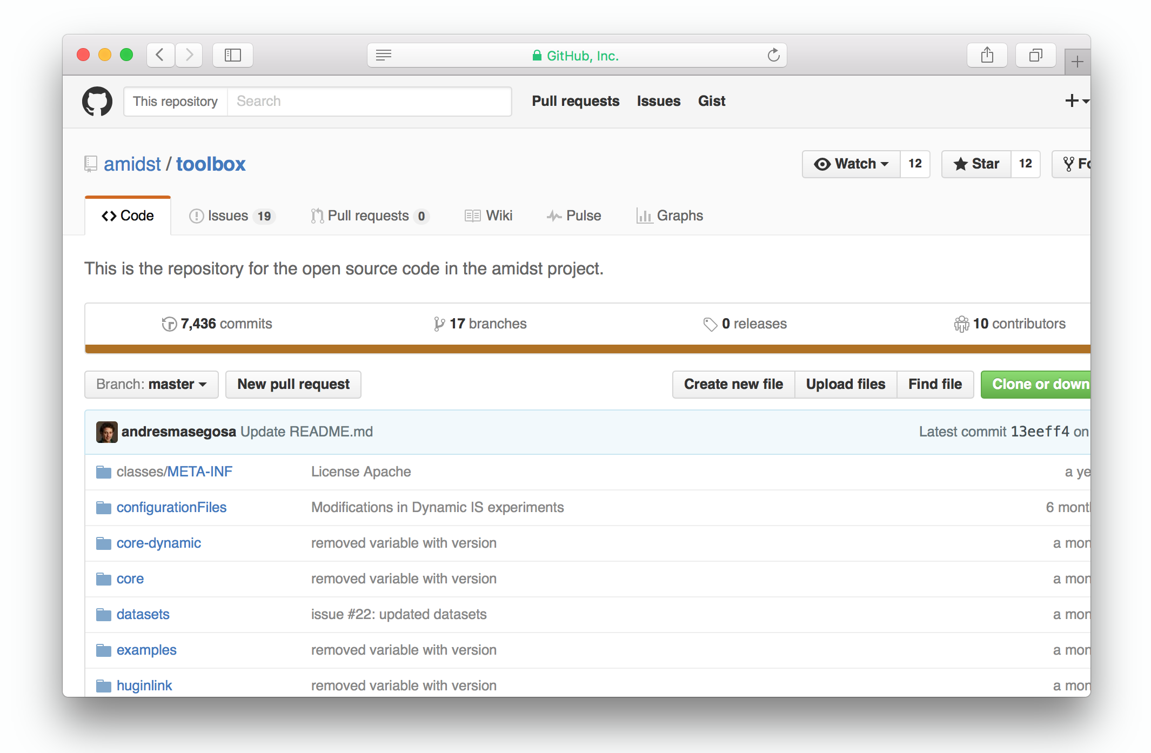
Important URLs
http://amidst.github.io/toolbox/
(Documentation, tutorials and more)
https://github.com/amidst/toolbox
(source code)
http://amidst.github.io/toolbox/tutorial-huginsa.zip
(material for this tutorial)
Notes:
Notes:
$ java -version : note that there is only one dash ‘-’.
Explain that for making the toolbox work, we need Java8. But the IntelliJ IDEA is only needed for following this tutorial

Slide 3
System Requirements
Check your java version:
http://www.oracle.com/technetwork/java/javase/downloads/
$ java -version
https://www.jetbrains.com/idea/
Notes:
Notes:
$ java -version : note that there is only one dash ‘-’.
Explain that for making the toolbox work, we need Java8. But the IntelliJ IDEA is only needed for following this tutorial

Slide 4
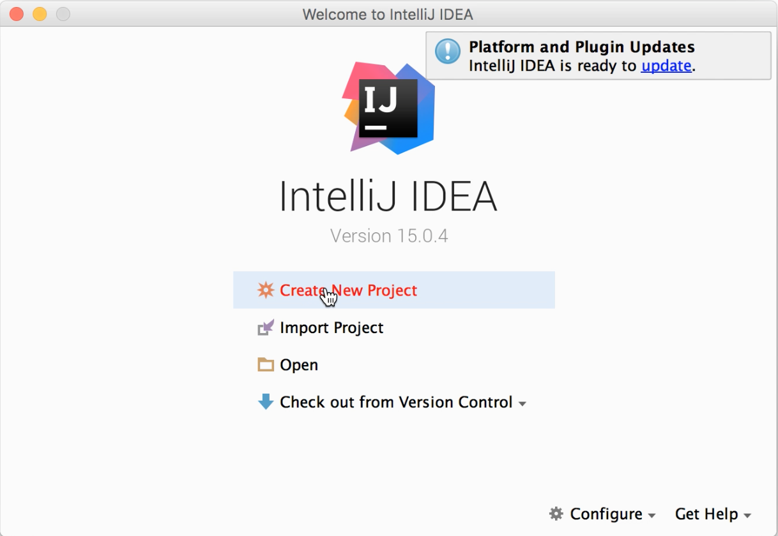
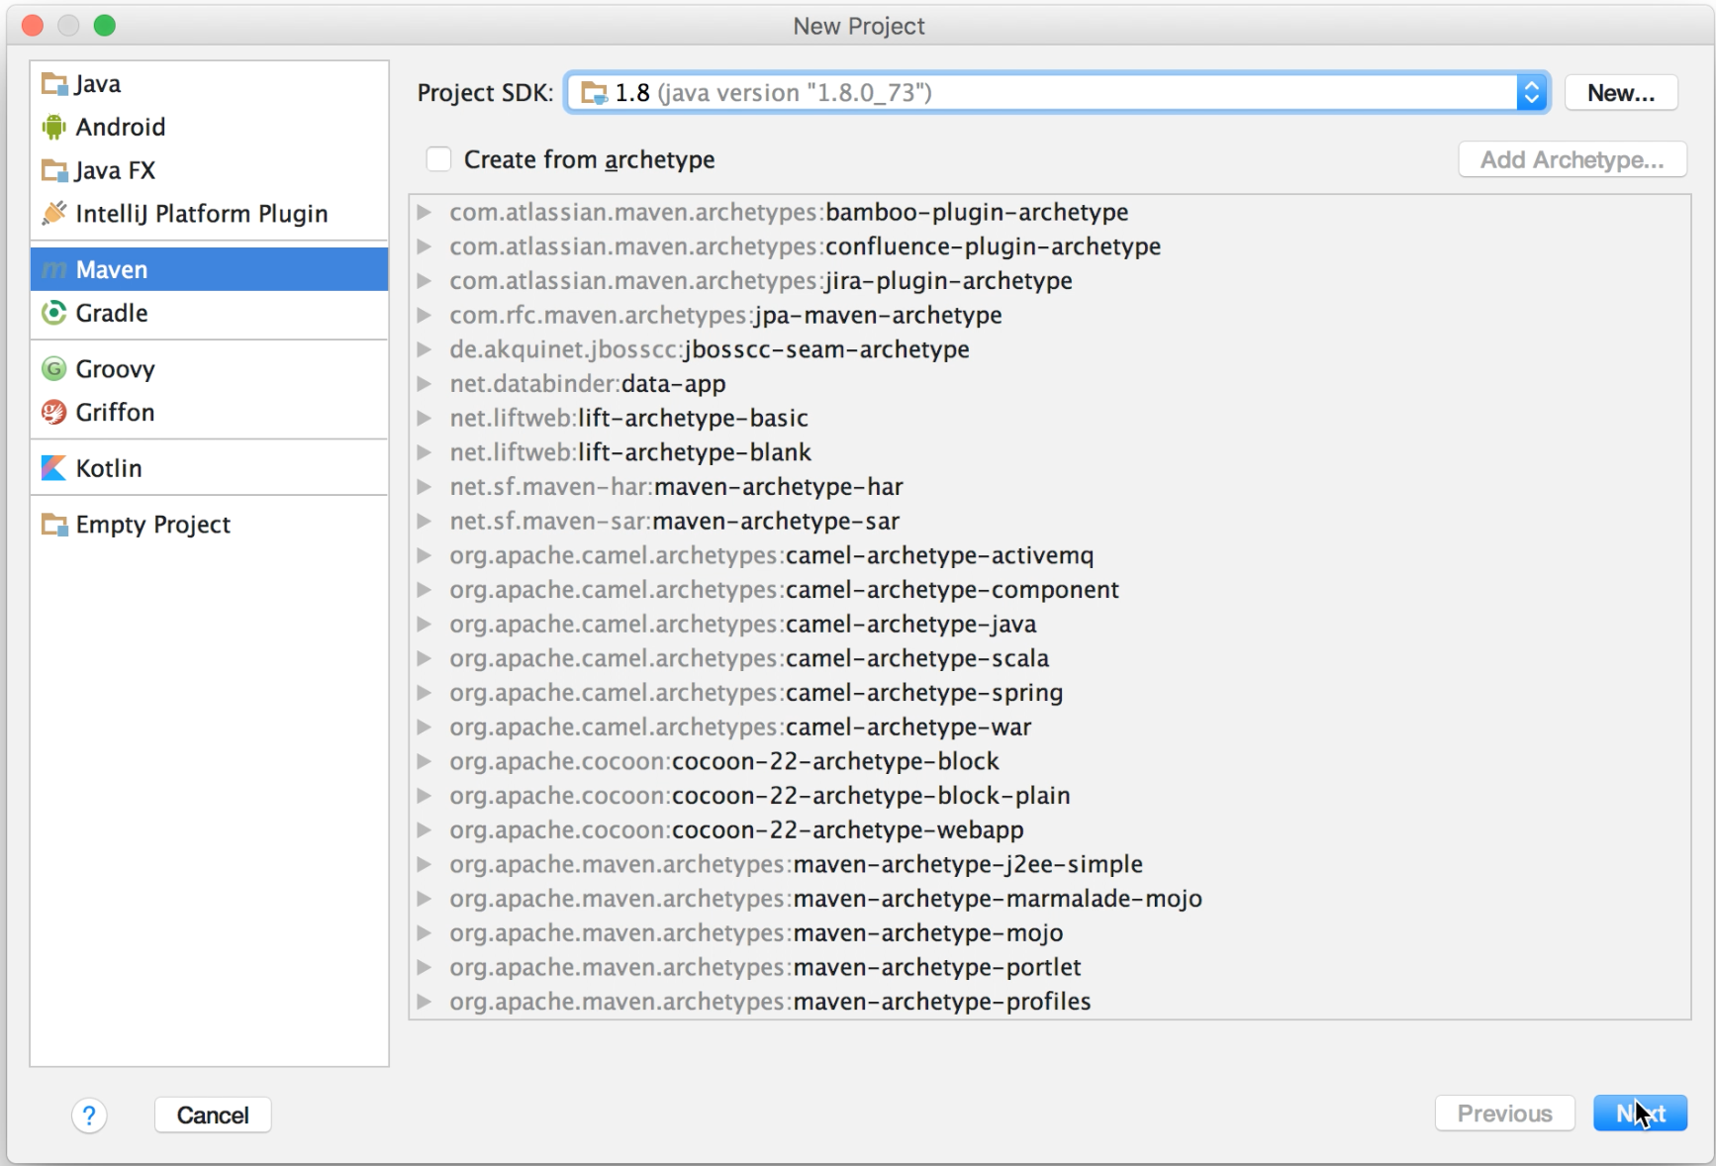
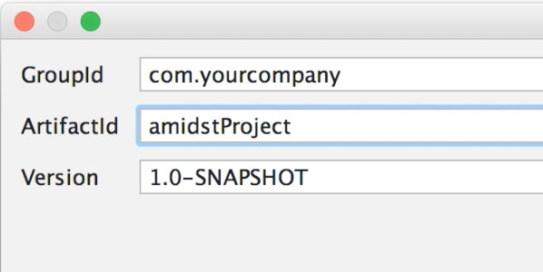
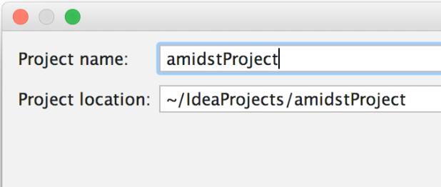
Setting up
Step 1: Create an empty maven project

Slide 5
Setting up
Step 2: Add repository and dependencies in the file pom.xml
<?xml version="1.0" encoding="UTF-8"?> <project xmlns="http://maven.apache.org/POM/4.0.0" xmlns:xsi="http://www.w3.org/2001/XMLSchema-instance" xsi:schemaLocation="http://maven.apache.org/POM/4.0.0 http://maven.apache.org/xsd/maven-4.0.0.xsd"> <modelVersion>4.0.0</modelVersion> <groupId>eu.amidst.testrepo</groupId> <artifactId>testgithubmavenrepo</artifactId> <version>1.0-SNAPSHOT</version> <repositories> <!-- AMIDST repository in github --> <repository> <id>amidstRepo</id> <url>https://raw.github.com/amidst/toolbox/mvn-repo/</url> </repository> <!-- ... → </repositories>
<dependencies> <!-- Load one of the modules from AMIDST Toolbox --> <dependency> <groupId>eu.amidst</groupId> <artifactId>latent-variable-models</artifactId> <version>0.4.3-alpha</version> <scope>compile</scope> </dependency> <!-- ... --> </dependencies> </project>
repository
modules

Slide 6
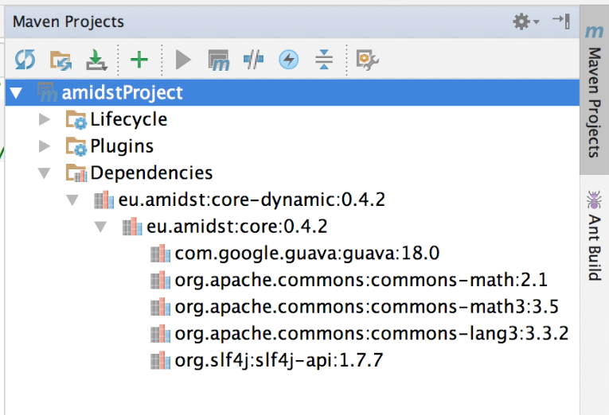
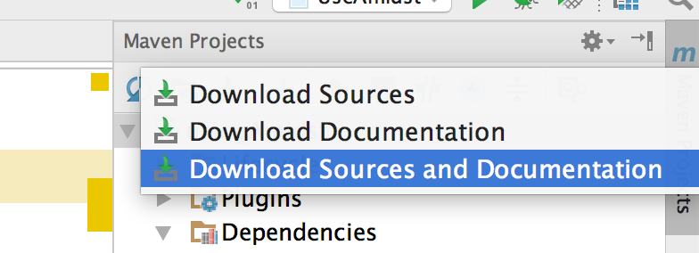
Setting up
Step 3: Download source code and javadoc

Slide 7
ARFF format
The toolbox can read datasets saved as .arff (Attribute-Relation File Format) files.
dynamicDS_d2_c3.arff:
Open dynamicDS_d0_c5.arff and dynamicDS_d5_c0.arff
@relation dataset
@attribute SEQUENCE_ID real
@attribute TIME_ID real
@attribute DiscreteVar0 {0.0, 1.0}
@attribute DiscreteVar1 {0.0, 1.0}
@attribute GaussianVar0 real
@attribute GaussianVar1 real
@attribute GaussianVar2 real
@data
0,0,0.0,1.0,-11.218928287639379,-9.705288659121928,12.064058511499582
0,1,0.0,0.0,-1.5520768000994851,-4.280081986112549,21.056630499175807
0,2,0.0,0.0,-0.6333905987574826,-2.4527733264023213,37.116863464076864
0,3,0.0,0.0,-1.3737198121876433,-0.23170101600416873,63.662971350021095
. . .

Slide 8
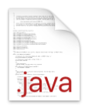
Static models (learning)
public class StaticModelLearning { public static void main(String[] args) { //Load the datastream String filename = "datasets/simulated/exampleDS_d0_c5.arff"; DataStream<DataInstance> data = DataStreamLoader.openFromFile(filename); //Learn the model Model model = new FactorAnalysis(data.getAttributes()); ((FactorAnalysis)model).setNumberOfLatentVariables(3); model.updateModel(data); BayesianNetwork bn = model.getModel(); System.out.println(bn); } }
StaticModelLearning.java

Slide 9
Static models (learning from flink)
public class StaticModelFlink { public static void main(String[] args) throws FileNotFoundException { //Load the datastream String filename = "datasets/simulated/exampleDS_d0_c5.arff"; final ExecutionEnvironment env = ExecutionEnvironment.getExecutionEnvironment(); DataFlink<DataInstance> data = DataFlinkLoader.loadDataFromFile(env, filename, false); //Learn the model Model model = new FactorAnalysis(data.getAttributes()); ((FactorAnalysis)model).setNumberOfLatentVariables(3); model.updateModel(data); BayesianNetwork bn = model.getModel(); System.out.println(bn); } }
StaticModelFlink.java

Slide 10
Static models (save to disk)
// Save with .bn format BayesianNetworkWriter.saveToFile(bn, "networks/simulated/exampleBN.bn"); // Save with hugin format BNWriterToHugin.saveToHuginFile(bn, "networks/simulated/exampleBN.net");
Note: make sure that you have the following files in your classpath:
hgapi83_amidst-64.jar
libhgapi83_amidst-64.jnilib
For adding folders to your class path:
-Djava.library.path=“….”
StaticModelSaveToDisk.java
Notes:
-Djava.library.path="huginlink/huginlib/"

Slide 11
Static models (inference)
Add the following code after learning the model
//Variabeles of interest Variable varTarget = bn.getVariables().getVariableByName("LatentVar2"); Variable varObserved = null; //we set the evidence Assignment assignment = new HashMapAssignment(2); varObserved = bn.getVariables().getVariableByName("GaussianVar1"); assignment.setValue(varObserved,6.5); //we set the algorithm InferenceAlgorithm infer = new VMP(); infer.setModel(bn); infer.setEvidence(assignment); //query infer.runInference(); Distribution p = infer.getPosterior(varTarget); System.out.println("P(LatentVar2|GaussianVar1=6.5) = "+p);
new HuginInference();
new ImportanceSampling();
StaticModelInference.java

Slide 12
Static models (practice)
Create your custom model: gaussian mixture
H
Discrete hidden variable
X1
X2
Xn
Continuous variables
Assume that observed variables are not connected

Slide 13
Static models (practice)
Some tips:
public class CustomGaussianMixture extends Model{ public CustomGaussianMixture(Attributes attributes) throws WrongConfigurationException { super(attributes); //TODO: Write the contructor code here }
@Override protected void buildDAG() { //TODO: Write the code building a DAG for your custom model } }
Useful methods:
public Variable Variables::newMultinomialVariable(String name, int nOfStates)
public List<ParentSet> DAG::getParentSets()

Slide 14
Dynamic models (learning)
public class DynamicModelLearning { public static void main(String[] args) { //Load the datastream String filename = "datasets/simulated/exampleDS_d0_c5.arff"; DataStream<DynamicDataInstance> data = DynamicDataStreamLoader.loadFromFile(filename); //Learn the model DynamicModel model = new HiddenMarkovModel(data.getAttributes()); ((HiddenMarkovModel)model).setNumStatesHiddenVar(4); model.setWindowSize(200); model.updateModel(data); DynamicBayesianNetwork dbn = model.getModel(); System.out.println(dbn); } }
DynamicModelLearning.java

Slide 15
Dynamic models (save to disk)
// Save with .bn format BayesianNetworkWriter.save(bn, "networks/simulated/exampleBN.bn"); // Save with hugin format BayesianNetworkWriterToHugin.save(bn, "networks/simulated/exampleBN.net");
Note: make sure that you have the following files in your classpath:
hgapi83_amidst-64.jar
libhgapi83_amidst-64.jnilib
For adding folders to your class path:
-Djava.library.path=“….”
DynamicModelSaveToDisk.java
Notes:
-Djava.library.path="huginlink/huginlib/"

Slide 16
Dynamic models (inference)
Add the following code after learning the process
//Testing dataset String filenamePredict = "datasets/simulated/exampleDS_d0_c5_small.arff"; DataStream<DynamicDataInstance> dataPredict = DynamicDataStreamLoader.loadFromFile(filenamePredict); //Select the inference algorithm InferenceAlgorithmForDBN infer = new FactoredFrontierForDBN(new VMP()); infer.setModel(dbn); Variable varTarget = dbn.getDynamicVariables().getVariableByName("discreteHiddenVar"); UnivariateDistribution posterior = null; //Classify each instance int t = 0; for (DynamicDataInstance instance : dataPredict) { infer.addDynamicEvidence(instance); infer.runInference(); posterior = infer.getFilteredPosterior(varTarget); System.out.println("t="+t+", P(discreteHiddenVar | Evidence) = " + posterior); }
new HuginInference();
new ImportanceSampling();
DynamicModelInference.java

Slide 17
Dynamic models (inference)
For predicting 5 steps ahead, replace:
posterior = infer.getFilteredPosterior(varTarget);
posterior = infer.getPredictivePosterior(varTarget, 5);
DynamicModelInference.java

Slide 18
Dynamic models (practice)
Create your custom dynamic model: Kalman filter
H₁
H_{m}
H₁
H_{m}
H₁
H_{m}
X₁
X₂
X₃
X_{n}
X₁
X₂
X₃
X_{n}
X₁
X₂
X₃
X_{n}
t₀
t_{i-1}
t_{i}
Assume that hidden variables are not connected among them
All the variabels are continuous

Slide 19
Dynamic models (practice)
Some tips:
public class CustomKalmanFilter extends DynamicModel {
public CustomKalmanFilter(Attributes attributes) throws WrongConfigurationException { super(attributes); //TODO: Write the constructor code here } @Override protected void buildDAG() { }
}
Useful methods:
public DynamicVariable DynamicVariables::newGaussianDynamicVariable (String name)
public Variable DynamicVariable ::getInterfaceVariable()
public ParentSet DynamicDAG::getParentSetTimeT(Variable var)

Slide 20
Parallel TAN (Hugin/AMIDST)
Hugin: learn the structure with a subsample of the data
AMIDST: learn the parameters in AMIDST using the whole data.
ParallelTAN tan = new ParallelTAN(); tan.setNumCores(4); tan.setNumSamplesOnMemory(1000); tan.setNameRoot(var01); tan.setNameTarget(classVar); BayesianNetwork model = tan.learn(data);

